Slide 1
Lab
Inventory
Management &
Borrowing
System
Catherine Bradsher
Heman Kolla
Christian Marinkovich
Kellie Ng
Billy Wu
Miranda Zheng
Notes:
general application overview
honeycomb + laws of ux changes
demo
security changes
Wireframes
Responsibilities
Techstack
Show database
Future implementations
Stakeholders
Target users
Key features

Slide 2
Table of contents
01
02
03
Introduction
Features
Development
Intro to LIMBS!
Features!
What frontend +
backend did
04
05
Demo
Reflections
LIMBS!!
Future plans + Reflections
Notes:
Heman

Slide 3
Introduction
LIMBS streamlines tracking, management, and restocking of items within a lab or a shop
Allows users to efficiently check out and return reusable equipment
Enhance accountability for materials and equipment to reduce the burden of manually tracking inventory
Notes:
Heman

Slide 4
Stakeholders
Professors
Automated systems will help keep track of equipment means professors don’t have to spend time doing so themselves.
Shop Student Leadership
Increased accountability for lab equipment means student leaders will have to spend less on replacing lost items, and can get more out of their groups’ budget.
Lab Students
Forgetful students will also be less likely to accidentally lose or walk away with equipment, as they will have a written record of which items they have checked out.
Notes:
Heman

Slide 5
Requirements
Functional
Inventory Management + Search
Users can view, search, and manage lab items; administrators can add, update, and remove items.
User Authentication
Secures access with user accounts and restricts inventory management to authorized users.
Borrowing + Returning System
Users can check out and return items, with LIMBS tracking borrower details and updating availability.
Non Functional
Usability
Has an intuitive interface for easy navigation and task completion.
Security
Secure authentication and authorization will protect sensitive user and inventory data.
Scalability
Handles growth in users and inventory without performance issues.
Notes:
Heman

Slide 6
Project
Features
Notes:
Kellie
2-3 mins
Aim for 2.5

Slide 7
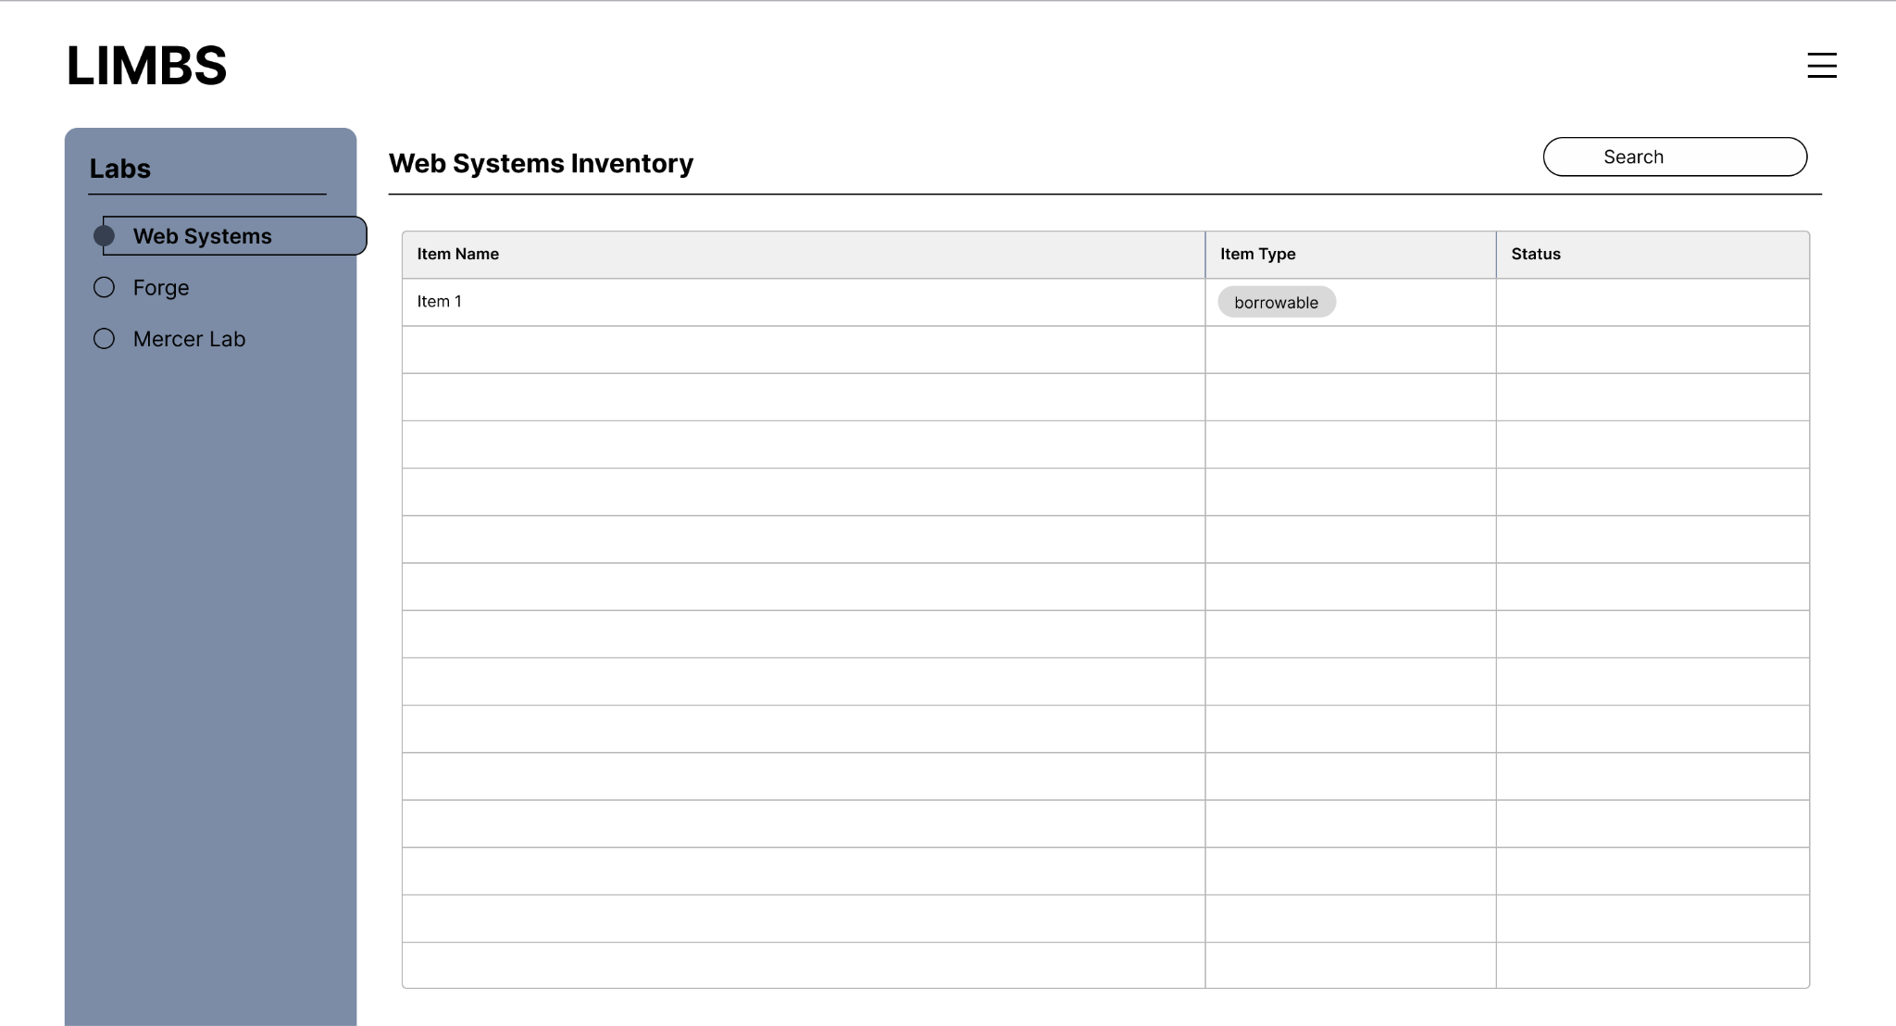
All labs in one place.
Have information for all labs compiled and easily accessible in one place.
Notes:
Kellie

Slide 8
Streamline inventory tracking.
Track, restock, and manage lab or shop items with ease. Control inventory access, monitor equipment usage, and ensure accountability—all through a centralized system.
Notes:
Kellie

Slide 9
Simplify equipment checkout & reservations.
Reserve and check out lab or shop items effortlessly, ensuring availability and reducing conflicts, all while keeping an accurate record of usage.
Notes:
Kellie

Slide 10
Ensure
Accountability
Reserve and check out lab or shop items effortlessly, ensuring availability and reducing conflicts, all while keeping an accurate record of usage.
Notes:
Kellie

Slide 11
Project
Development

Slide 12
SCRUM
Timeline
SPRINT ONE
SPRINT TWO
SPRINT THREE
Frontend Development
Wireframing
Optimizations
Planning + Project Proposal
Site Map
Connecting Frontend + Backend
Database Schema
Backend Development
Security Measures
Notes:
Billy

Slide 13
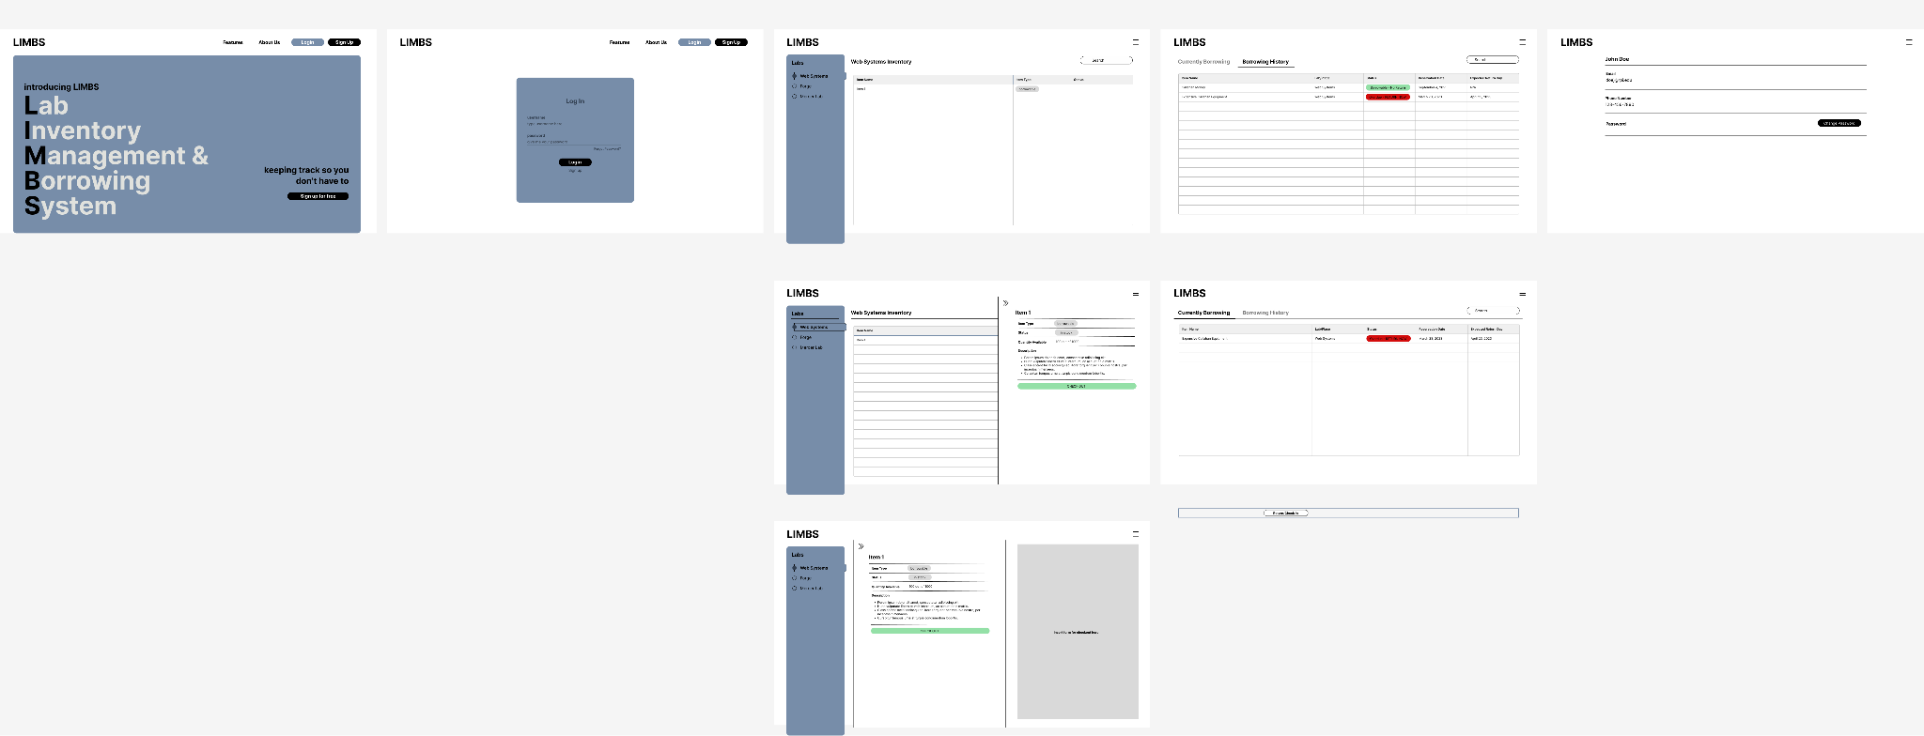
SPRINT ONE
Wireframe
Initial wireframing to establish the what the team wanted to app to look like. This is a mockup the general “flow” of the site.
Notes:
Catherine

Slide 14
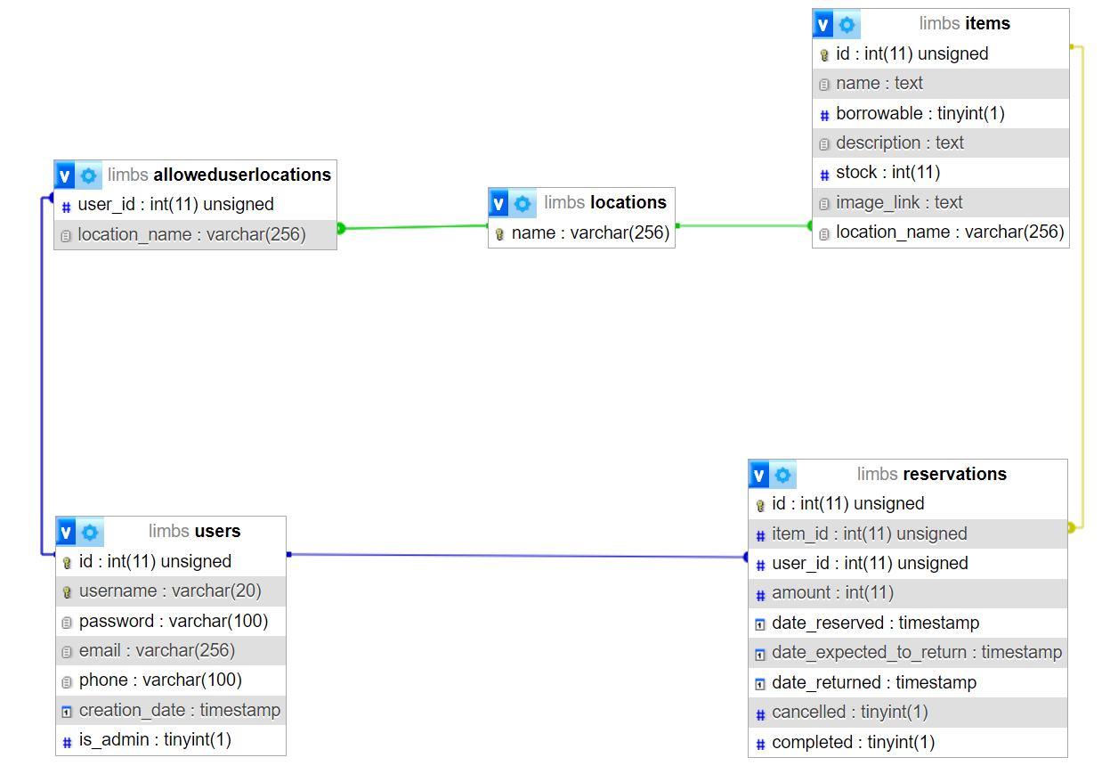
SPRINT ONE
Database Schema
This schema established the basic structure of the database and how different parts of the system interact with each other.
Notes:
Billy

Slide 15
SPRINT TWO
Frontend Development
Used HTML and CSS to create the website
Used JS to create a mock-up of full functionality for our midterm presentation
Information pages (landing, features, about us pages)
Login + Signup pages (form verification)
Dashboards (lab pages + borrowing history)
Account Management (profile + change password)
Notes:
Catherine

Slide 16
SPRINT TWO
Backend Development
Focused heavily on querying data from the database
Making sure the functionality on the frontend is in the backend.
Show all labs a user can access
Display items in lab & formatting them to be readable
Getting information for a single item
Checking out & reserving an item
Logging in and out
Admin abilities to add/edit an item
Admin abilities to add a user to a lab
Notes:
Billy
We wanted to focus heavily on querying data from the database
And so we wrote a comprehensive set of queries before starting
Basic functionalities we wanted to focus on:
Show the labs a user can access
Display items in lab & formatting them to be readable
Getting information for a single item
Checking out & reserving an item
Logging in and out
As we continued developing, we realized we needed to add a lot more queries to make our site almost fully functional. Some of the subsequent queries we ended up implementing were:
Ability to search for items
Admin abilities to add/edit an item
Admin abilities to add a user to a lab
PHP Security
What exists on the frontend needs to exist on the backend.

Slide 17
SPRINT THREE
Optimizations + UI/UX Choices
highly contrasting colors to make it more visible and accessible (Aesthetic-Usability Effect)
keeping everything in sections to make our site more efficient and readable (Chunking)
Notes:
Catherine

Slide 18
SPRINT THREE
Security Measures
Database Connection Password Written Server-Side with nano
Passwords not publicly available on GitHub Rep
Binding Parameters for SQL Statement Execution
Protects against SQL injections
Limiting Form Response Length
Protects against possible Buffer Overflow & DoS + Data Injection attacks
Passwords Hashed in Database
Makes it more difficult for hackers
Notes:
Heman - this should be the 10 minute mark

Slide 19
DEMO!
Notes:
User: Miranda - will show existing acc, then demonstrate signup at end
Admin: Christian - will add new user to their lab

Slide 20
Group Dynamics
What worked well:
Using GitHub Projects & Issues
Scrum Workflow
Consistent Scrum Meetings
Well-Documented Logs
Frequent Use of the Discord Channel
What didn’t work well:
Not having a clear idea of how the system would work
Spent a lot of scrum meetings talking though the system
Notes:
Heman

Slide 21
Thank you!
Questions?
Notes:
Questions: ALL

